Slide 1
CS 4350: Fundamentals of Software Engineering Lesson 7.3 Structural Testing
Adeel Bhutta, Frank Tip, Jan Vitek, Mitch Wand
Khoury College of Computer Sciences
© 2021 Released under the CC BY-SA license
Notes:
HI

Slide 2
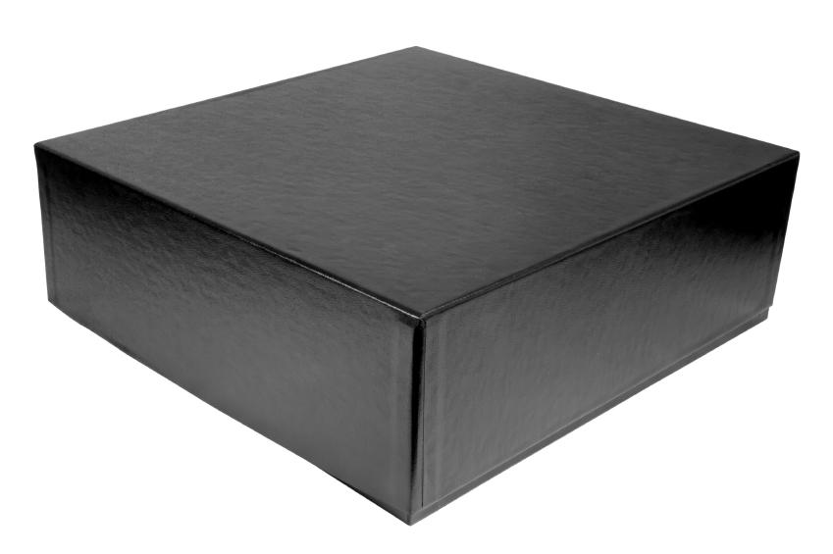
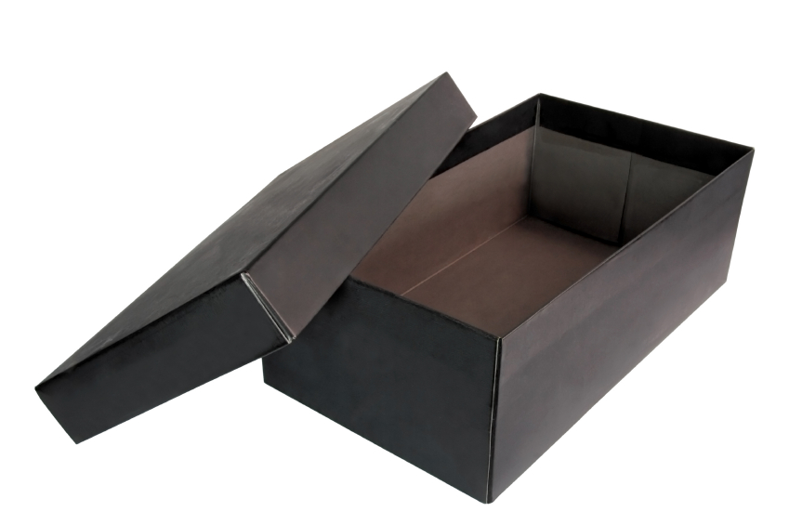
Black-Box vs. White-Box Testing
Functional “black box”
Structural “white box”
Tests based on specification
Test covers as much specified behavior as possible
Tests based on code
Test covers as much implemented behavior as possible
Notes:
In the previous two lessons, we learned about functional or black-box testing.
In black-box testing, the focus is on checking specified behavior, and the goal is to test as much specified behavior as possible.
In this lesson, we will focus on structural or white-box testing, where the focus is on testing as much implemented behavior as possible.

Slide 3
Why Structural?
Functional “black box”
Structural “white box”
If a part of the program is never executed, a defect may loom in that part A “part” can be a statement, function, transition, condition…
Attractive because it can be automated
Notes:
So why are we interested in structural testing?
A: your tests can only find defects in parts of code that they execute!
Therefore, it is useful to execute as many “parts” of the program as possible
Here parts can be statements, functions, modules, conditions, and so on.
Structural testing can be automated, using code coverage tools to determine what still needs to be covered, and to help you understand how thorough your test suite is.

Slide 4
Why Structural?
Functional “black box”
Structural “white box”
Complements functional tests Run functional tests first, then measure what is missing
Can cover low-level details missed in high-level specification
Notes:
Structural testing complements functional testing.
Functional testing only considers requirements, so it can find defects that occur because a requirement was not implemented. Structural testing can only find problems in features that were implemented.
On the other hand, structural testing can cover low-level details missed in high-level specifications

Slide 5
A Challenge
class Roots { // Solve ax² + bx + c = 0 public solve(double a, double b, double c){ … }
// Result: values for x double root_one, root_two; }
Which values for a, b, c should we test? assuming a, b, c, were 32-bit integers, we’d have (2³²)³ ≈ 10²⁸ legal inputs with 1.000.000.000.000 tests/s, we would still require 2.5 billion years
Notes:
Consider the following class for computing the roots of a quadratic equation
The method “solve” takes three arguments, a, b, and c
Which values for a, b, and c should we consider in our tests?
If a, b, and c are 32-bit integers, there are 10^28 possible legal inputs
Not feasible to test them all

Slide 6
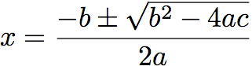

The Code
// Solve ax² + bx + c = 0 public solve(double a, double b, double c) { double q = b * b - 4 * a * c; if (q > 0 && a ≠ 0) { // code for handling two roots }
else if (q == 0) { // code for handling one root }
else { // code for handling no roots } }
Test this case
and this
and this!
Notes:
But looking at the code, we can see that we first compute q, which is the value that we need to compute the square root of. (CLICK).
There are three cases to consider.
the case where q > 0 and a not equal to 0 (CLICK)
the case where q = 0 (CLICK)
and all situations where q and a do not meet the previous two conditions

Slide 7
The Test Cases
// Solve ax² + bx + c = 0 public solve(double a, double b, double c) { double q = b * b - 4 * a * c; if (q > 0 && a ≠ 0) { // code for handling two roots }
else if (q == 0) { // code for handling one root }
else { // code for handling no roots } }
(a, b, c) = (3, 4, 1)
(a, b, c) = (0, 0, 1)
(a, b, c) = (3, 2, 1)
Notes:
So we can try to construct an input that corresponds to each case.
For the first branch, we can choose a=3, b=4, c=1 (CLICK)
For the second branch, we can choose, a=0, b=0, c=1 (CLICK)
And for the last branch, we can choose a=3, b=2, c=1 (CLICK)

Slide 8
A Defect
// Solve ax² + bx + c = 0 public solve(double a, double b, double c) { double q = b * b - 4 * a * c; if (q > 0 && a ≠ 0) { // code for handling two roots }
else if (q == 0) { x = (-b) / (2 * a); }
else { // code for handling no roots } }
(a, b, c) = (0, 0, 1)
↯
code must handle a = 0
Notes:
Now consider what happens when we choose a=0, b=0, c=1
We would divide by zero, which causes a run-time error!
In other words, we just found ourselves a defect!
This illustrates how systematic exploration of a program’s branches can uncover errors!

Slide 9
Expressing Structure
// Solve ax² + bx + c = 0 public solve(double a, double b, double c) { double q = b * b - 4 * a * c; if (q > 0 && a ≠ 0) { // code for handling two roots }
else if (q == 0) { x = (-b) / (2 * a); }
else { // code for handling no roots } }
Notes:
So how can we systematically explore a program so that we can find as many bugs as possible?

Slide 10
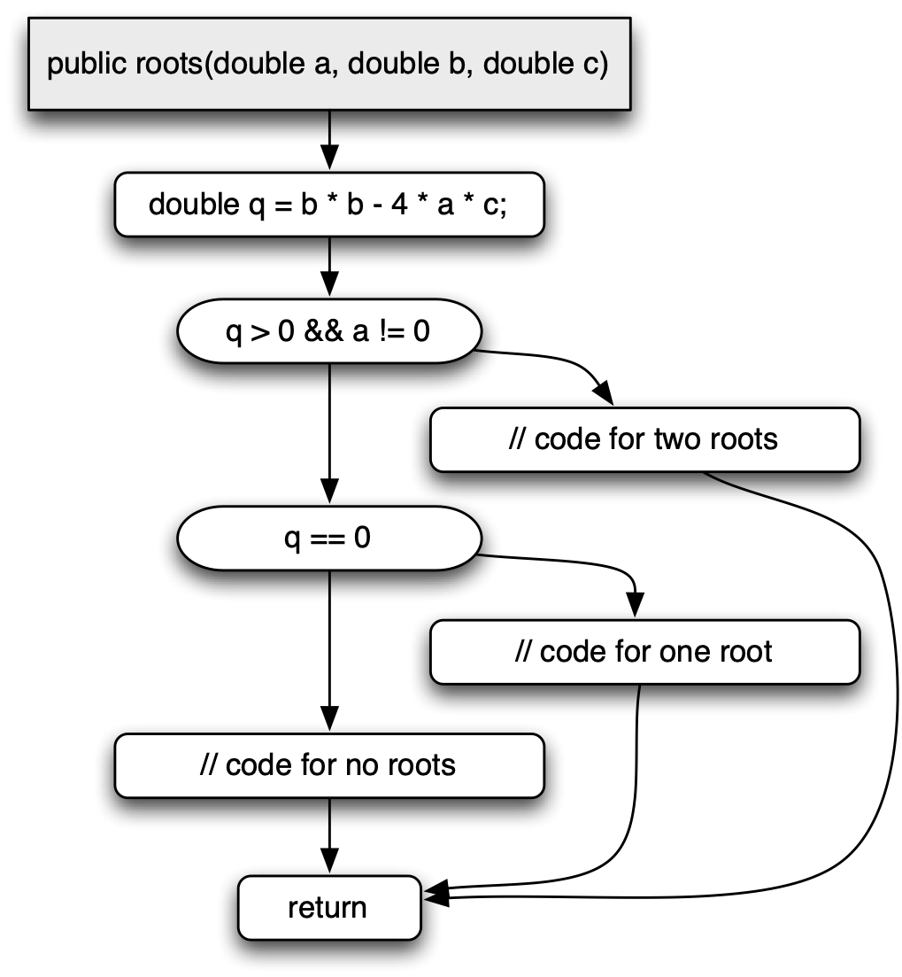
Control Flow Graph
A control flow graph expresses paths of program execution
Nodes are basic blocks – sequences of statements with one entry and one exit point
Edges represent control flow – the possibility that the program execution proceeds from the end of one basic block to the beginning of another
solve
Notes:
Control-flow graphs are widely used to represent the control-flow paths in programs.
The nodes in a CFG correspond to basic blocks — sequences of statements that have one entry point and one exit point
The edges in a CFG correspond to possible transitions from one basic block to another
For example, for the node corresponding to the if-condition (q >0 and aa != 0), there are two outgoing edges, to nodes corresponding to the true branch and the false branch.

Slide 11
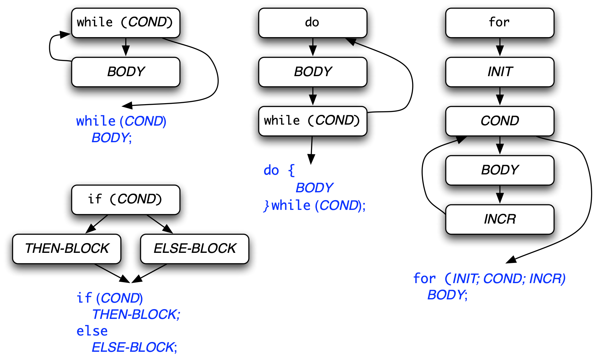
Control Flow Patterns
Notes:
On the last slide, we discussed a case where an if-statement gave rise to two branches in the CFG.
Similarly, other control-flow constructs give rise to distinct patterns
For example, while-loops, do-loops, and for-loops all give rise to cyclical structures in the CFG

Slide 12
Structural Testing
The CFG can serve as an adequacy criterion for test cases
The more parts are covered (executed), the higher the chance of a test to uncover a defect
“parts” can be: nodes, edges, paths, conditions…
solve
Notes:
We can use the CFG as an adequacy criterion for test cases by requiring that a test suite covers all parts of a CFG
Here, parts can refer to nodes, edges, paths, etc..

Slide 13
cgi_decode
/** * @title cgi_decode * @desc * Translate a string from the CGI encoding to plain ascii text * ’+’ becomes space, %xx becomes byte with hex value xx, * other alphanumeric characters map to themselves * * returns 0 for success, positive for erroneous input * 1 = bad hexadecimal digit */
int cgi_decode(char *encoded, char *decoded)
{ char *eptr = encoded; char *dptr = decoded; int ok = 0;
A
Notes:
As an example how to use a CFG to define a notion of test adequacy, we will consider a function cgi_decode or CGI decoding.
The program is written in C, but the same idea applies to TypeScript.
When we start building a CFG for this program, the first basic block consists of the three declarations at the beginning of the function. For convenience, we’ll label this block “A”

Slide 14
while (*eptr) /* loop to end of string (‘\0’ character) */ { char c; c = *eptr; if (c == ’+’) { /* ‘+’ maps to blank */ *dptr = ’ ’;
} else if (c == ’%’) { /* ’%xx’ is hex for char xx */ int digit_high = Hex_Values[*(++eptr)]; int digit_low = Hex_Values[*(++eptr)];
if (digit_high == -1 || digit_low == -1) ok = 1; /* Bad return code */
else *dptr = 16 * digit_high + digit_low;
} else { /* All other characters map to themselves */ *dptr = *eptr; }
++dptr; ++eptr; }
*dptr = ‘\0’; /* Null terminator for string */ return ok; }
B
C
E
D
G
I
H
F
L
M
Notes:
The slide shows the rest of the cgi_decode function.
As you can see, there is a while-loop and several if-conditions
As a result, there are 10 additional basic blocks that we’ll label B-M for convenience

Slide 15
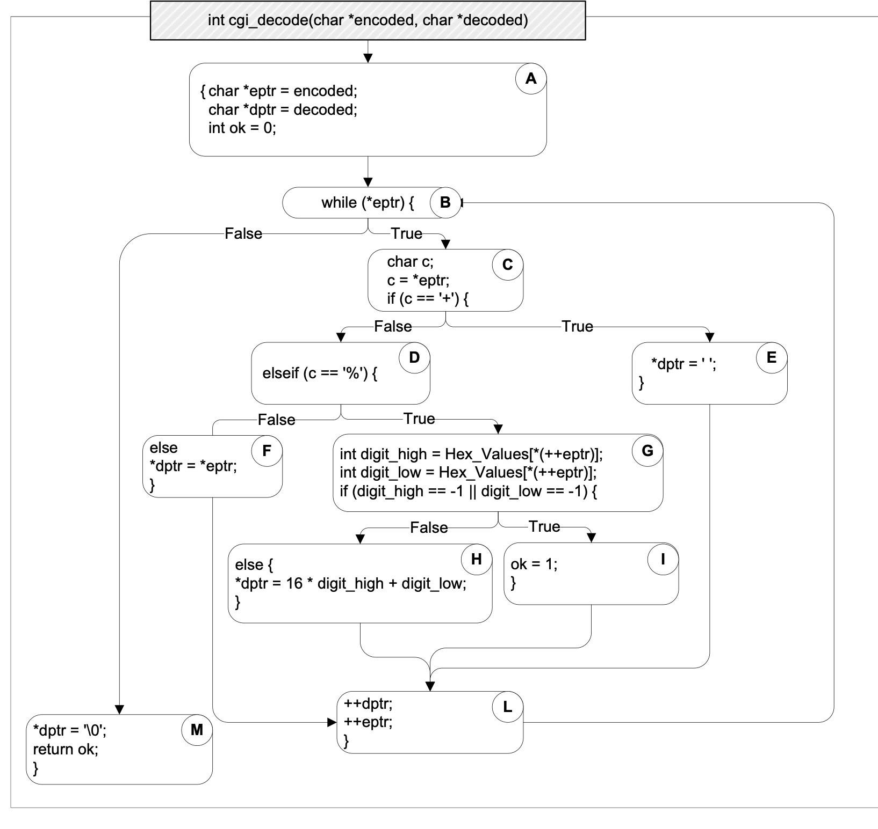
A
B
C
D
E
F
G
H
I
L
M
(from Pezze + Young, “Software Testing and Analysis”, Chapter 12)
Notes:
This is what cgi_decode looks as a CFG.

Slide 16

“test”
✔
A
✔
B
C
✔
D
E
✔
F
✔
G
H
I
✔
L
M
✔
Notes:
Now, let’s consider the execution of a test, and how it corresponds to nodes in the CFG.
Here, the input consists of the string “test”;
While the program executes, one statement (or basic block) after the other is covered – i.e., executed.
we will use checkmarks to indicate executed blocks.
as you can see, the loop is traversed once for each character in the input. When execution ends, nodes E, G, H, and I have not been executed: they remain un-covered

Slide 17
“test”
✔
A
✔
B
C
✔
D
E
✔
F
✔
G
H
I
✔
L
M
✔
Notes:
While the program is executed, one statement (or basic block) after the other is covered – i.e., executed at least once – but not all of them. Here, the input is “test”; checkmarks indicate executed blocks.

Slide 18
“test”
✔
“a+b”
A
✔
B
C
✔
D
E
✔
✔
F
✔
G
H
I
✔
L
M
✔
Notes:
We’d like to test every statement, so we come up with more test cases.
If we select a test case with a “+” character, block E is executed. We have increased our coverage!

Slide 19
“test”
✔
“a+b”
A
“%3d”
✔
B
C
✔
D
E
✔
✔
F
✔
G
✔
H
✔
I
✔
L
M
✔
Notes:
Similar, if we create a test case containing the % character, blocks G and H are covered

Slide 20
“test”
✔
“a+b”
A
“%3d”
“%g”
✔
B
C
✔
D
E
✔
✔
F
✔
G
✔
H
✔
I
✔
✔
L
M
✔
Notes:
and with this test case, block I as covered as well

Slide 21
Test Adequacy Criteria
How do we know a test suite is “good enough”?
A test adequacy criterion is a predicate that is true or false for a pair ⟨program, test suite⟩
Usually expressed in form of a rule – e.g., “all statements must be covered”
Notes:
Test adequacy criteria have been defined to determine if your test suite is good enough.
A test adequacy criterion is a predicate that is true of false for a given program and test suite
Usually expressed in the form of a rule e.g. “all statements must be covered”

Slide 22
Statement Testing
Adequacy criterion: each statement (or node in the CFG) must be executed at least once
Rationale: a defect in a statement can only be revealed by executing the defect
Coverage: # executed statements # statements
Notes:
Statement coverage criterion states that each statement (or CFG node) should be covered.
The rationale for this criterion is that a defect in a given statement can only be discovered if that statement is executed
You can express statement coverage as a percentage: <…>

Slide 23
“test”
✔
A
✔
B
C
✔
D
E
✔
F
✔
G
H
I
✔
L
M
✔
Notes:
Let’s apply this to the cgi_decode example
The initial coverage is 7/11 blocks = 63%.
(We could also count the statements instead (here: 14/20 = 70%), but conceptually, this makes no difference)

Slide 24
“test”
✔
“a+b”
A
✔
B
C
✔
D
E
✔
✔
F
✔
G
H
I
✔
L
M
✔
Notes:
and the coverage increases with each additionally executed statement…
if we add the second test, coverage increases to 72%

Slide 25
“test”
✔
“a+b”
A
“%3d”
✔
B
C
✔
D
E
✔
✔
F
✔
G
✔
H
✔
I
✔
L
M
✔
Notes:
Adding the third test increases coverage to 91%

Slide 26
“test”
✔
“a+b”
A
“%3d”
“%g”
✔
B
C
✔
D
E
✔
✔
F
✔
G
✔
H
✔
I
✔
✔
✔
L
M
✔
Notes:
And with adding the last test, we reach 100% block coverage (which is 100% statement coverage, too).

Slide 27

Computing Coverage
Coverage is computed automatically while the program executes
requires instrumentation at compile time
The Istanbul/NYC tool measure code coverage for TypeScript programs
supports several coverage criteria (statements, branches, lines, functions)
integrates with Mocha
*see example at https://github.com/philipbeel/example-typescript-nyc-mocha-coverage
Notes:
Many forms of coverage can be computed automatically using automated tools
This is typically done by instrumenting the program so that whenever a statement/block is executed, a corresponding counter is updated.
For JS/TS, the Instanbul/NYC tool can be used to compute coverage
example project: https://github.com/philipbeel/example-typescript-nyc-mocha-coverage

Slide 28
Branch Testing Criterion
each branch in the CFG must be executed at least once
coverage: # executed branches # branches
Subsumes statement testing criterion because traversing all edges implies traversing all nodes
Most widely used criterion in industry
Notes:
Another testing criterion is the branch testing criterion, which states that each branch in the CFG should be executed at least once.
Branch coverage is defined as <..>
We say that the branch testing criterion subsumes the statement testing criterion
…because if a test suite satisfies the branch testing criterion for a given program, then it also satisfies the statement testing criterion for that program

Slide 29

Test Criteria
subsumes
Path testing
Theoretical Criteria
Boundary interior testing
Compound condition testing
MCDC testing
LCSAJ testing
Branch and condition testing
Practical Criteria
Branch testing
Loop boundary testing
Statement testing
Basic condition testing
Notes:
In general, there are many other testing criteria that can be used to assess the adequacy of a test suite.
Here is a diagram that shows a number of testing criteria
The diagram visualizes how the criteria relate to each other: here, An arrow from a criterion A to a criterion B means that A subsumes B.
for example, branch testing subsumes statement testing and we visualize this by drawing an arrow from the Branch Testing criterion to the Statement Testing criterion
This means that if a given test suite satisfies the branch testing criterion for a given program, then so does the statement testing criterion for that program

Slide 30
“+%0d+%4j”
✔
A
✔
B
C
✔
D
E
✔
✔
F
G
✔
H
✔
I
✔
If the conditional fails and the failure case code is missing, statement coverage would still get to 100%, even though there is a defect
✔
L
M
✔
Notes:
Why is branch testing useful?
Let’s consider a buggy version of the same cgi_decode program where block F is missing (CLICK)
Then, the input you see here would achieve 100% statement coverage without ever triggering the defect (CLICK until 100% is displayed
However, if the conditional evaluates to false, we would execute buggy code, so having 100% statement coverage does not mean that the program is free of errors

Slide 31
“+%0d+%4j”
A
B
C
D
E
F
G
H
I
L
M
Notes:
However, if we focus on whether branches have been taken, though, we get a different picture.
Here, we label each branch with “true” or “false”

Slide 32
“+%0d+%4j”
A
B
✔
✔
C
✔
✔
D
E
F
✔
G
✔
✔
H
I
L
M
Notes:
And if we track which branches are executed, we find that the test case executes only 7 out of 8 branches
In other words, branch coverage is 7/8 or 87%.

Slide 33
“+%0d+%4j”
A
“abc”
B
✔
✔
C
✔
✔
D
E
✔
✔
F
G
✔
✔
H
I
L
M
Notes:
If we another test case, such as “abc”, we can cover this remaining branch – and find the defect.

Slide 34
Condition Testing
Consider the defect (high == 1 || low == -1) // should be -1
Branch adequacy criterion can be achieved by changing only low
i.e., the defective sub-expression may never determine the result
Faulty sub-condition is never tested
although we tested both outcomes of the branch
Notes:
Branch testing is a more rigorous testing criterion than statement testing, but it still has its limitations
Consider the situation where a condition consists of two sub-conditions, as in this example
Here, a condition consists of (high == 1 || low == -1), where the first subcondition has a bug
It is possible for this condition to evaluate to true or false based only on the value of low
so you can test both outcomes of this branch without ever executing the buggy code

Slide 35
Condition Testing
Key idea: cover individual conditions in compound boolean expression
e.g., both parts of high == 1 || low == -1
Note: this criterion applies to all compound conditions, not just those used in if/while statements
Notes:
Condition testing addresses this limitation, but requiring that all individual conditions in compound conditions are covered
Note: this criterion applies to all compound conditions, not just those used in if/while statements

Slide 36
Basic Condition Testing Adequacy Criterion
each basic condition must be evaluated at least once
Coverage: # truth values taken by all basic conditions 2 * # basic conditions
Note that this criterion does not subsume branch coverage
100% basic condition coverage
but only 87% branch coverage
“test+%9k%k9”
Notes:
The basic condition adequacy criterion states that each basic condition must be evaluated at least once
and coverage can be computed as the # truth values taken by all basic conditions divided by 2 * the number of basic conditions
note that basic condition coverage does not subsume branch coverage.
for the following test case for cgi_decode, we achieve 100% basic condition coverage but only 87% branch coverage

Slide 37
Test Criteria
subsumes
Path testing
Theoretical Criteria
Boundary interior testing
Compound condition testing
MCDC testing
LCSAJ testing
Branch and condition testing
Practical Criteria
Branch testing
Loop boundary testing
Statement testing
Basic condition testing
Notes:
Here is a view of the diagram of test criteria again.
As you can see, the basic condition criterion is not comparable with branch or statement coverage criteria – neither subsumes the other.

Slide 38
Test Criteria
subsumes
Path testing
Theoretical Criteria
Boundary interior testing
Compound condition testing
MCDC testing
LCSAJ testing
Branch and condition testing
Practical Criteria
Branch testing
Loop boundary testing
Statement testing
Basic condition testing
Notes:
But we can define a combined “Branch and Condition Testing” criterion by requiring that all conditions and all decisions should be covered.
This criterion requires that every sub-condition must evaluate to true and false, and the entire condition as well.
This criterion subsumes both branch testing and basic condition testing

Slide 39
Test Criteria
subsumes
Path testing
Theoretical Criteria
Boundary interior testing
Compound condition testing
MCDC testing
LCSAJ testing
Branch and condition testing
Practical Criteria
Branch testing
Loop boundary testing
Statement testing
Basic condition testing
Notes:
Another idea is simply to test all possible combinations. This is called compound condition testing.

Slide 40
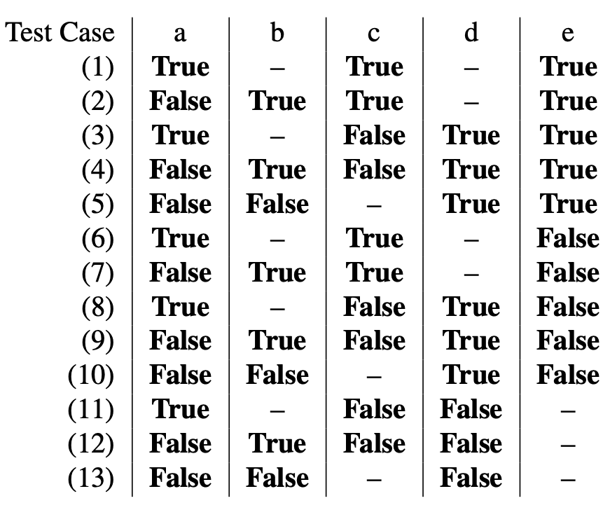
Compound Conditions
Assume (((a ∨ b) ∧ c) ∨ d) ∧ e)
In the general case, we get a combinatorial explosion
short-circuit evaluation often reduces this to a more manageable number
Here, we need 13 tests to cover all possible combinations
Notes:
Assume that we have the compound condition that you see here.
In the general case, we get a combinatorial explosion
short-circuit evaluation often reduces this to a more manageable number —
for example if a is true, then b is never evaluated
in this case, there are 13 combinations (to understand why, try drawing this as a decision tree)

Slide 41
Test Criteria
subsumes
Path testing
Theoretical Criteria
Boundary interior testing
Compound condition testing
MCDC testing
LCSAJ testing
Branch and condition testing
Practical Criteria
Branch testing
Loop boundary testing
Statement testing
Basic condition testing
Notes:
The combinatorial explosion is the reason why compound condition testing is a theoretical, rather than a practical criterion.
In practice, it is not feasible to apply this criterion to programs of realistic size
In the diagram, we will draw a line to separate the theoretical testing criteria from the practical ones

Slide 42
Test Criteria
subsumes
Path testing
Theoretical Criteria
Boundary interior testing
Compound condition testing
MCDC testing
LCSAJ testing
Branch and condition testing
Practical Criteria
Branch testing
Loop boundary testing
Statement testing
Basic condition testing
Notes:
A possible compromise is Modified Condition/Decision Coverage (or MC/DC) testing.

Slide 43
MCDC Testing
Modified Condition Decision Coverage
Key idea: Test important combinations of conditions, to avoid exponential blowup
A combination is “important” if each basic condition is shown to independently affect the outcome of each decision
MCDC testing is mandatory for some avionics software:
see https://www.faa.gov/aircraft/air_cert/design_approvals/air_software/media/AR-01-18_MCDC.pdf
Notes:
In MCDC testing, the key idea is to test important combinations of conditions
Here, a combination of conditions is important if each basic condition is shown to independently affect the outcome of each decision
This criterion is legally required for certain safety-critical applications, e.g. in certain types of avionics software

Slide 44
MCDC Testing
Modified Condition Decision Coverage
For each basic condition C, we need two test cases T1 and T2 such that the following conditions hold:
values of all evaluated conditions except C are the same
compound condition as a whole evaluates to true for T1 and false for T2
provides a good balance of thoroughness and test size (and therefore widely used)
Notes:
The basic idea for MCDC testing is that for each basic condition C, we need to have two test cases T1 and T2 such that:
values of all evaluated conditions except C are the same
compound condition as a whole evaluates to true for T1 and false for T2.
(in other words, is observed to determine the outcome of the entire compound condition)

Slide 45
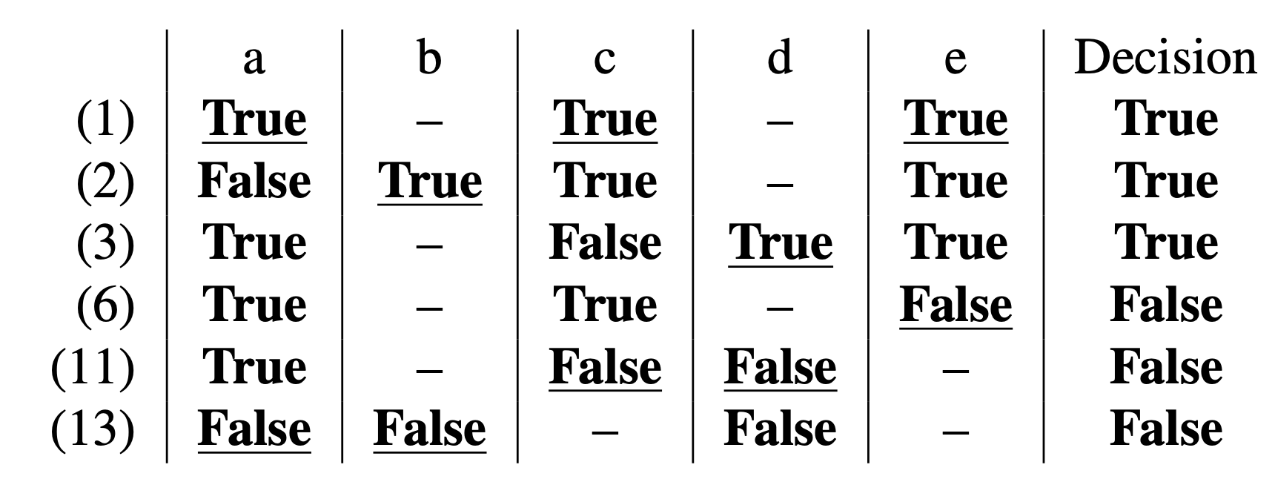
MCDC Testing
Modified Condition Decision Coverage
Assume (((a ∨ b) ∧ c) ∨ d) ∧ e)
We need six tests to cover MCDC combinations
underlined values independently affect the decision
Notes:
This example illustrates MCDC testing. We show 6 tests (numbered 1, 2, 3, 6, 11, and 13). For each test, we show the value for a,b,c,d, and e.
Underlined values that independently affect the outcome of the decision (changing any one of these would affect the overall outcome).
As an example: consider the highlighted rows: here b determines the outcome of the decision because the value for a is the same, and they don’t share any of the other basic conditions.
In this case, these 6 tests together achieve MCDC coverage. In general, there may be multiple test suites that achieve MCDC coverage.

Slide 46
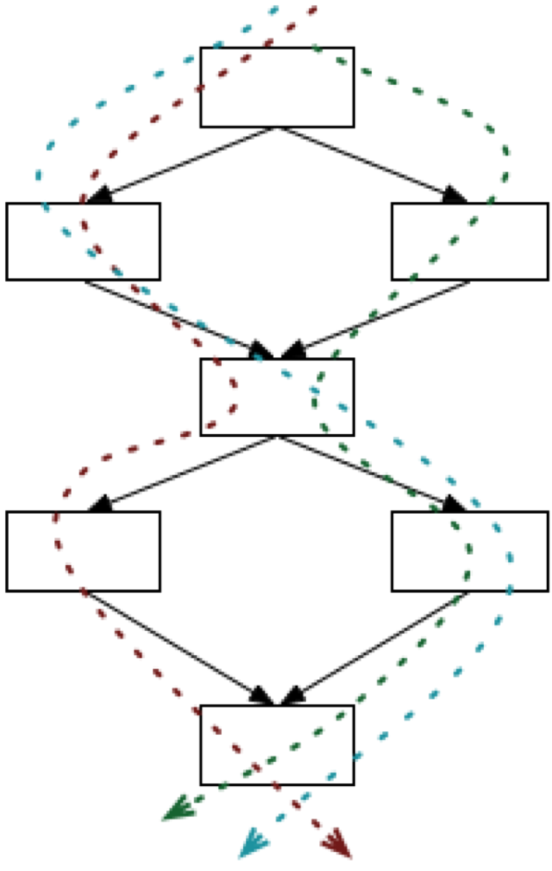
Path Testing
beyond individual branches
Key idea: explore sequences of branches in control flow
Many more paths than branches calls for compromises
Notes:
The next testing criterion we consider is path testing
This criterion is not practical because, in the presence of loops, the number of paths may be infinite

Slide 47
Test Criteria
subsumes
Path testing
Theoretical Criteria
Boundary interior testing
Compound condition testing
MCDC testing
LCSAJ testing
Branch and condition testing
Practical Criteria
Branch testing
Loop boundary testing
Statement testing
Basic condition testing

Slide 48
Test Criteria
subsumes
Path testing
Theoretical Criteria
Boundary interior testing
Compound condition testing
MCDC testing
LCSAJ testing
Branch and condition testing
Practical Criteria
Branch testing
Loop boundary testing
Statement testing
Basic condition testing
Notes:
Here is the diagram again, with path testing included
Note that it subsumes many other criteria.

Slide 49
Test Criteria
subsumes
Path testing
Theoretical Criteria
Boundary interior testing
Compound condition testing
MCDC testing
LCSAJ testing
Branch and condition testing
Practical Criteria
Branch testing
Loop boundary testing
Statement testing
Basic condition testing
Notes:
Boundary interior testing groups together paths that differ only in the subpath they follow when repeating the body of a loop.
In other words, we follow each path in the CFG up to the first repeated node.

Slide 50
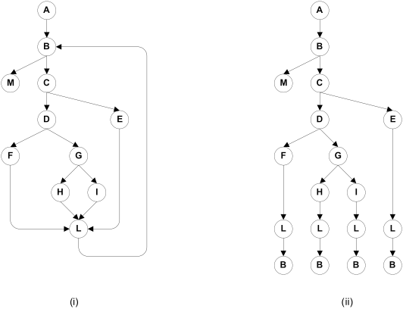
Boundary Interior Adequacy
for cgi_decode
Original CFG
Paths to be covered
Notes:
Here is an example to illustrate boundary interior testing.
We follow each path in the CFG up to the first repeated node.
The graph at the right shows the paths that must be covered in the CFG at the left

Slide 51
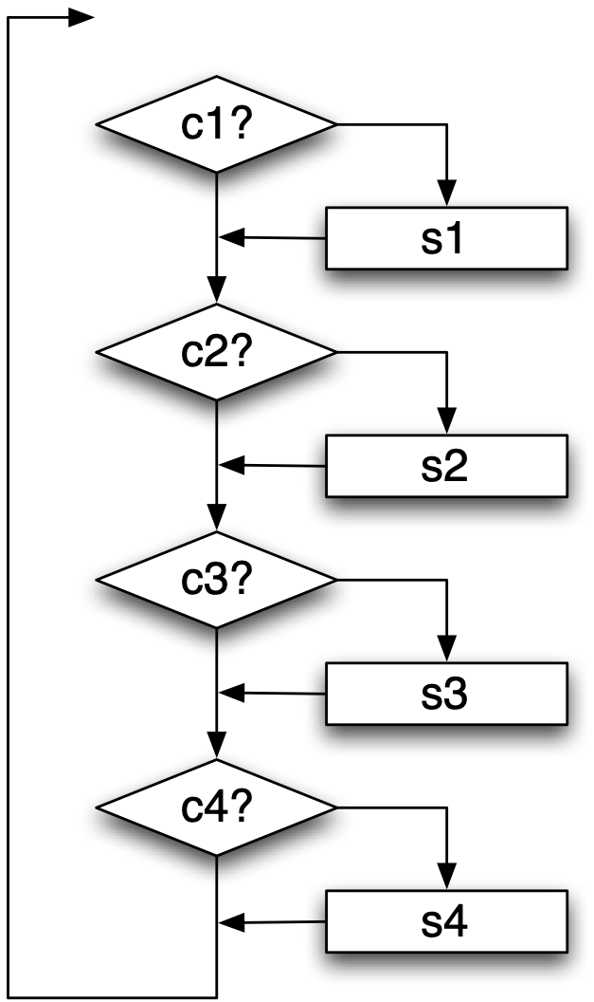
Boundary Interior Testing: Issues
The number of paths may still grow exponentially
In this example, there are 2⁴ = 16 paths
Forcing paths to be executed may be infeasible
or even impossible if conditions are not independent
Notes:
Boundary interior testing is not a practical testing criterion because the number of paths to be considered may still grow exponentially
in this example you see here, with 4 conditions, there are 2^4 = 16 paths for which test cases would have to be constructed

Slide 52
Test Criteria
subsumes
Path testing
Theoretical Criteria
Boundary interior testing
Compound condition testing
MCDC testing
LCSAJ testing
Branch and condition testing
Practical Criteria
Branch testing
Loop boundary testing
Statement testing
Basic condition testing
Notes:
Another alternative is loop boundary testing which forces constraints on how loops are to be executed. This is a practical criterion.

Slide 53
Loop Boundary Adequacy
A test suite satisfies the loop boundary adequacy criterion if for every loop L:
There is a test case that iterates L zero times
There is a test case that iterates L once
There is a test case that iterates L more than once
Typically combined with other adequacy criteria such as MCDC
Notes:
<…>

Slide 54
“”
A
“a”
“abc”
0
1
≥ 2
B
0
1
C
≥ 2
D
E
F
G
H
I
L
M
Notes:
Let’s consider how loop boundary testing can be applied to the cgi_decode example (CLICK)
We have to cover three cases: where the loop body is traversed 0 times, once, and more than once (CLICK)
To cover the first case, we can provide the empty string (CLICK)
To cover the second case, we can provide a string containing a single character “a” (CLICK)
To cover the third case, we can provide a string containing the text “abc” (CLICK)
So with these three test cases, we obtain loop boundary adequacy for the cgi_decode main loop.

Slide 55
LCSAJ Adequacy
Testing all paths up to a fixed length
LCSAJ = Linear Code Sequence And Jump
A LCSAJ is a sequential subpath in the CFG starting and ending in a branch
LCSAJ length | corresponds to
1 | statement coverage
2 | branch coverage
n | coverage of n consecutive LCSAJs
∞ | path coverage
Notes:
A final testing criterion that we will consider is the Linear Code Sequence And Jump criterion.
This involves testing paths in the CFG that start and end in a branch, up to a fixed length.
If paths of length 1 are considered, this criterion corresponds to statement coverage
If paths of length 2 are considered, the LCSAJ criterion corresponds to branch coverage
And considering paths of infinite length is essentially considering full path coverage.

Slide 56
Test Criteria
subsumes
Path testing
Theoretical Criteria
Boundary interior testing
Compound condition testing
MCDC testing
LCSAJ testing
Branch and condition testing
Practical Criteria
Branch testing
Loop boundary testing
Statement testing
Basic condition testing
Notes:
This concludes our overview of structural testing techniques.
Here is the diagram that shows all criteria and how they subsume each other.

Slide 57
Satisfying Adequacy Criteria: Challenges
Statements may not be executed because of defensive programming or code reuse
Conditions may not be satisfiable because of interdependent conditions
Paths may not be executable because of interdependent decisions
Notes:
There are some challenges associated with satisfying test adequacy criteria
sometimes statements may not be executed because of defensive programming or code reuse
Conditions may not be satisfiable because of interdependent conditions
Paths may not be executable because of interdependent decisions

Slide 58
Reaching Specific Code can be Hard/Impossible!
Even the best-designed, best-maintained systems may contain unreachable code
Solutions: allow coverage less than 100%,
require justification for exceptions
A large amount of unreachable code/paths/conditions is a serious maintainability problem
Notes:
Even the best-designed, best-maintained systems may contain unreachable code
Solutions: allow coverage less than 100%, or require justification for exceptions
A large amount of unreachable code/paths/conditions is a serious maintainability problem

Slide 59

Summary
Notes:
This concludes our lessons on Structural Testing.
We have discussed how structural testing complements functional testing
and presented various coverage criteria along with the subsumption relationships between them
We will be practicing some of the presented testing techniques in HW4

